Slide 2
Compiling Objective-C
Using the Visual Studio 2015 C++ Code Generation that Builds Windows, SQL, .Net, and Office
3-610
Salmaan Ahmed
- PM Windows
Jim Radigan
- Compiler Technologies

Slide 3
Cool technical stuff – what we ship in VS2015
Pull back and demo new developer tools built on this.

Slide 4
Mission:
New code generation technology in VS2015
Its used to build the entire company C/C++
All Universal Applications for C#
How this accrues to VS2015 retail products
Accrues to new compilers & languages for Windows

Slide 5
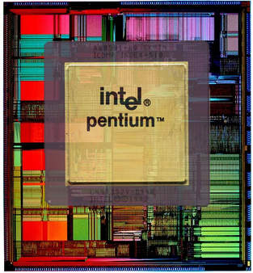
3,100,000 Transistors

Slide 6
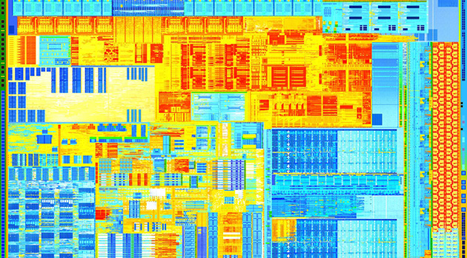
Ivy Bridge
1.4 Billion Transistors

Slide 7
New
Security
Asynchronous C++ programming model
Auto vectorization
Incremental Whole Program
Build time – for the developer

Slide 8
IE Aurora Hack – Google
Dangling pointer vulnerability
2. Copy evt, but fail to AddRef on CTreeNode!
<html><head><script>
var e1;
function f1(evt){
e1 = document.createEventObject(evt);
document.getElementById("sp").innerHTML = "";
window.setInterval(f2, 50);
}
function f2(){
var t = e1.srcElement;
}
</script></head>
<body>
<span id="sp">
<img src=“any.gif" onload=“f1(evt)">
</span>
</body></html>
3. Destroy img tag in span leading to free when evt falls out of scope
4. Call f2 async so evt goes out of scope
Hijack!
Vtable call via freed CTreeNode
1. Pass onload event (evt) to f1
Red is C++ called from javascript

Slide 9
Chum – in the water
mov eax, ecx
shr eax, 9
mov eax, dword ptr [0x20000000 + eax*4]
shr ecx, 4
bt eax, ecx
jb ok_to_call
int 3

Slide 10
Instrumentation: Data structures
Bitmap to check icall
  Windows modified
  Loader modified
  Linker and compiler paired
  Small binary format changes
  Binary static analysis (cracking binaries) changed
1
0
8 bytes
0
0
0
0
0
0
8 bytes
callable
memory

Slide 11
/Guard – new compiler switch
Performance – required close OS integration
Interoperation – required massive testing
Stopping zero day exploits today

Slide 12
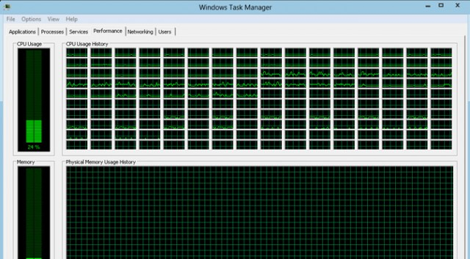
Multicore – clock rate is not increasing !

Slide 13
C++ - new asynchronous model
New MSFT C++ key words _yield and _await
True coroutines emitted from 4 code generators

Slide 14
Coroutine
generator<int> fib(int n)
{
int a = 0;
int b = 1;
while (n-- > 0)
{
yield a;
auto next = a + b;
a = b;
b = next;
}
}
int main() {
for (auto v : fib(35))
{
printf("%d\n", v);
if (v > 10)
break;
}
}

Slide 15
Execution
generator<int> fib(int n)
Suspend!!!!
RSP
auto g = fib(35)
Stack
ret-addr
g
RCX = &g (udtReturn$)
RDX = 35
slot1
savedRDI
&g
slot2
Heap
slot3
savedRSI
slot4
savedRDX
RDI = n
RSI = a
RDX = b
RBP = $fp
ret-main
savedRBP
Promise
slot1
slot2
RDI slot
slot3
slot4
saved RDI
RSI slot
saved RSI
RDX slot
saved RDX
RAX = &g
RIP slot
saved RIP

Slide 16
Efficient and Scalable
Scales to millions of concurrent coroutines
Cost of resume / suspend is comparable to that of a function call
Enables zero-overhead abstractions over existing async facilities
std::future<void> tcp_reader(int total) {
char buf[64 * 1024];
auto conn = await Tcp::Dial("127.0.0.1", 1337);
do
{
auto bytesRead = await conn.read(buf, sizeof(buf));
total -= bytesRead;
}
while (total > 0);
}
Only one memory allocation
~15 gb/s over loopback on a laptop
int main()
{
tcp_reader(1000 * 1000 * 1000).get();
}

Slide 17
C++ - Vectorizing complex control flow
for (…) {
if (cond) {
LHS1 = RHS1;
}
else {
LHS2 = RHS2;
}
}
for (i = 0; < N; i+=4…) {
mask = {cond,cond,cond,cond}
v1 = RHS1 & mask;
v2 = LHS1 & ! mask;
LHS1 = v1 | v2;
v3 = RHS2 & ! mask;
v4 = LHS2 & mask;
LHS2 = v3 | v4;
}

Slide 18
Blackscholes – vectorized
for (j=0; j<NUM_RUNS; j++) {
for (i=start; i<end; i++) {
...
if (InputX < 0.0) { // control flow1
InputX = -InputX;
sign = 1;
} else
sign = 0;
…
if (sign) { // control flow 2
OutputX = 1.0 - OutputX;
}
...
if (InputX < 0.0) { // control flow 3
InputX = -InputX;
sign = 1;
} else
sign = 0;
…
if (sign) { // control flow 4
OutputX = 1.0 - OutputX;
}
...
if (otype == 0) { // control flow 5
OptionPrice = (sptprice * NofXd1) - (FutureValueX * NofXd2);
} else {
NegNofXd1 = (1.0 - NofXd1);
NegNofXd2 = (1.0 - NofXd2);
OptionPrice = (FutureValueX * NegNofXd2) - (sptprice * NegNofXd1);
}
...
}
}
...
cmpltps xmm1, xmm2 // bit masked control flow 1
movaps xmm0, xmm2
subps xmm0, xmm3
movdqa XMMWORD PTR tv2980[esp+144], xmm1
movaps xmm4, xmm1
movaps XMMWORD PTR tv2987[esp+144], xmm0
movaps xmm0, xmm2
xorps xmm0, XMMWORD _xmm@80000000800000008000000080
andnps xmm4, xmm0
movaps xmm0, xmm1
andps xmm0, xmm2
orps xmm4, xmm0
...
pcmpeqd xmm1, xmm3 // bit masked control flow 2
movaps xmm3, xmm1
subps xmm0, xmm2
andps xmm2, xmm1
xorps xmm1, xmm1
andnps xmm3, xmm0
orps xmm3, xmm2
…
(continuing on next slide)

Slide 19
Vectorizing control flow
PARSEC\blackscholes 600% speedup on AVX2, 388% speedup on SSE2.
Numerical Recipe\ks2d1s 476% speedup on AVX2, 309% speedup on SSE2.
Geekbench_mini\sobel 231% speedup on SSE2.
Eigne\quatmul 229% speedup on SSE2

Slide 20

Profile Guided Optimization (Xbox One)
Profile Guided Optimization (PGO) is now available for Xbox One titles since the June XDK 2014.
Seen bigs wins (10-20%) for many big Xbox One titles (Forza, Kinect Sports Rival, Fable Legends and more).
PGO and Forza (Xbox One)
Forza receives a 14% improvement on Game thread, and 4% gain on render thread on top of LTCG.

Slide 21
Scenario
#1. Developer scenario
#2. Build Lab Scenario
BUILD
DEBUG
EDIT
CLEAN BUILD
Developer does this #40 times a day
Product build nightly!

Slide 22
Build Time – At a glance

Slide 23
Incremental Whole Program (Fast LTCG)
Benchmark | VS2013 RTM | VS2015
(sec) | Incremental Whole Prog. | Incremental Whole Prog.
C2 | 129 | 13
MSHTML | 140 | 87
DXAML | 240 | 220

Slide 24
Example - edit
// WPA proves a,b,c not aliased
void foo(int * a, int * b, int * c, int count) {
for (int i = 0; i < count; i++) {
c[i] = c[i] + a[i] * b[i];
}
}
// WPA proves a,b,c not aliased
void foo(int * a, int * b, int * c, int count) {
for (int i = 0; i < count; i++) {
c[i] = a[i] * b[i];
}
}
// Imagine 100,000 other un-changed functions, 500 files
int bar() {
__declspec(align(16)) int a[128], b[128], c[128];
foo(a, b, c, 128);
// Other stuff
// ...
}
Only 1 function recompiled !!

Slide 25
Incremental build - workflow
CIL
Edited
CIL
Full Build
Incremental Build
c2.dll
IPDB
c2.dll
IPDB
.obj
.obj
link.exe
link.exe
exe/dll
exe/dll
IPDB = Incremental Program Database

Slide 26
Incremental scenarios (/O2)
Benchmark | VS2013 RTM |  |  |  | VS2015
(sec) | E2E | FE | BE | Link | E2E | FE | BE | Link
Chrome (ILK) | 228.5 | 3 | 0.1 | 225 | 13.6 | 3.1 | 0.1 | 10
Chome (F) | 1023.5 | 9 | 0.5 | 1014 | 499.7 | 9.2 | 0.5 | 490
Ogre3D | 34 | 0.3 | 0.02 | 72 | 18 | 0.3 | 0.02 | 31
Epoch | ~ | ~ | ~ | 620 | ~ | ~ | ~ | 68
Auto7 | 1.08 | ~ | ~ | ~ | 1.18 | ~ | ~ | ~

Slide 27
/debug:fastlink
Linker spends a vast majority of time in creating PDB files
/debug:fastlink improves link speed (2x on average) by generating new format PDB’s.
DIA API(s) used by debugger have been modified to provide a seamless debugging experience.

Slide 28

VS2015 compilers build Windows - every day!
$87.7 B
$100 .0B +

Slide 29
Code generators building Windows in the VS2015 product
Also are used to compile:
SQL
Office
.Net
Visual Studio
Windows futures

Slide 30
Code generation is responsible for:
  Instruction Set Architecture
  Performance
  ABI
  Security
  Interop
  Runtime semantics
  Debugging
  GC & AutoRefCounting
  Errors and warnings

Slide 31
C/C++
Ivy Bridge
Code Generation
C2.dll
linker
binder
.EXE .DLL
1.4 Billion Transistors

Slide 32
API + ABI
C# (MSIL)
C/C++
C# version
Code Generation
C2.dll
linker
binder
.EXE .DLL
STL
BOOST
WinRT
Framework-1
.Net Native Framework
Class Library
Runtime-1
CRT140.dll
MRT100.dll
Ntdll.dll
Windows Executive Layer

Slide 33
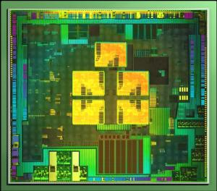
API x ABI x Hardware
USR.EXE
STL
BOOST
WinRT
Framework-1
.Net Native Framework
Class Library
Runtime-1
CRT140.dll
MRT100.dll
Ntdll.dll
ARM 32 (4 core)
Windows Executive Layer

Slide 34
C/C++
C/C++
.exe
.exe
ARM 32
X64
C/C++
C/C++
.exe
.exe
x86
new - fall

Slide 35



Top Down - C++ broad cross platform
Windows
iOS
Android
C#, CX
ObjC, Swift
Java
----------
C++
----------
C++ CLANG
----------
C++
CLANG

Slide 36
Clang/C2 - for C++ and 4 MSFT ABI(s)
C++ tests:
82% internal VC++ tests across 4 architectures
Applications:
BingRequest sample and the CppRESTSDK
(EH, Boost, async, STL, Windows headers)

Slide 37
CLANG/C2 – Objective-C
Demo – with full Windows debug support

Slide 38
Windows – Objective-C team
Salmaan Ahmed

Slide 39


  Candy Crush Saga: Brought to Windows Phone with very few code changes

Slide 40
Project Islandwood

Slide 41
Write Universal Windows Apps in Objective-C
What is Project Islandwood?
Objective-C language support
Compiler and Runtime
Useful and usable APIs
iOS API compat
Tools
Editor / Workflow
Project import

Slide 42
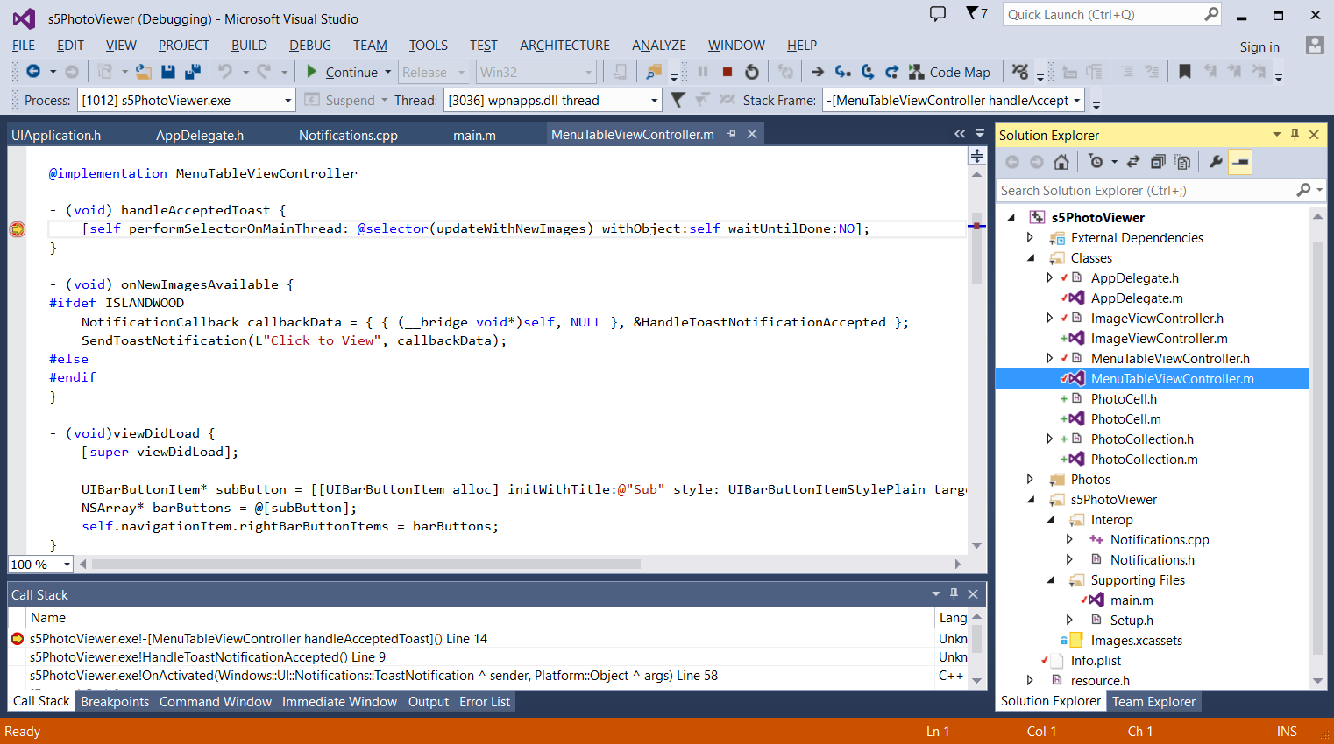
Tooling
Integrated Visual Studio Development
Integrated language support: syntax highlighting, autocomplete
Xcode projects imported to Visual Studio
Universal API Interop
Full debugging: breakpoints, stack traces, …

Slide 43
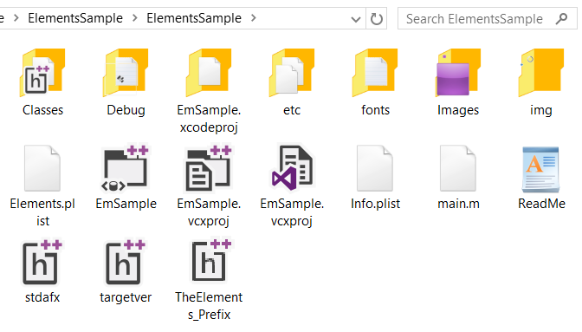
Tooling
Xcode projects imported to Visual Studio
Shared project settings, imported from Xcode

Slide 44
Demo

Slide 45
You are writing a Windows App
  With ObjC as a supported lang
Interop with Universal API surface
  And reuse code that uses some iOS APIs
Recap

Slide 46
Not limited to fixed screen sizes: UIApplicationStartupMode category for startup conditions
OperationMode for form factor
appBackButtonPressed: callback for physical back button
Customize

Slide 47
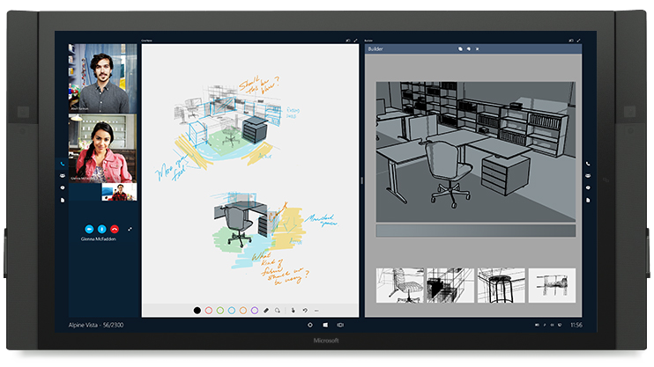
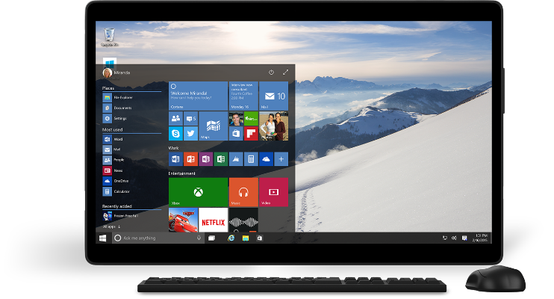



Works across Win10 devices
Deploy to more devices
Across multiple form-factors
Running ARM and x86/64 CPUs

Slide 48
Services and APIs

Slide 49
API Compatibility
Supports a subset of iOS APIs
Games: OpenGL (ANGLE, CAEAGLLayer, EAGLContext), OpenAL, Sensors
UI: UIKit, CoreAnimation, CoreGraphics, CoreText, Touch
Objective-C: ARC, blocks
Foundation / CoreFoundation
Services: StoreKit, Social, Notifications, …
Does not track a particular version of iOS
Most used APIs are implemented first

Slide 50





Windows does the heavy lifting for you
We translate and redirect iOS concepts to Windows concepts
FileSystem paths are mapped;
don’t need to reorganize your
project/assets
Backed by Windows Notifications
and appear in Action Center
StoreKit bridged to Windows
Store Transactions; very few code
changes required
Sharing
In-App Purchase
Notifications
File system
Camera
User experience
Monetization services
Platform
Windows 10

Slide 51
Proven compatibility
  Candy Crush Saga: Brought to Windows Phone with very few code changes
  Interop used for native integration
    In-App Purchase
    Local Notifications

Slide 52
Next Steps
Rolling out the SDK over the summer
http://aka.ms/islandwood
Visit our booth

Slide 53
Questions

Slide 54

Universal Windows Platform
Wherever your code was born, you can bring it to Windows
Windows Platform
Web Platform
Universal Windows 8 Apps (C++/C#/JS)
Universal Windows Platform
‘Project Spartan’ Rendering Engine
Universal Windows 10 Apps (C++/C#/JS)
Mobile
Desktop
Cordova Tooling (HTML/JS)
‘Project C’ (Classic Applications)
‘Project W’ (Web Apps – HTML/JS)
Universal
Windows Platform
IoT
Xbox
Middleware Platforms
Other Mobile Platforms
Middleware Partners (e.g., Xamarin)
Holographic
Surface Hub
‘Project A’ (Java/C++)
Game Engine Partners (e.g., Unity)
‘Project I’ (Objective C/C++)

